Slide 1
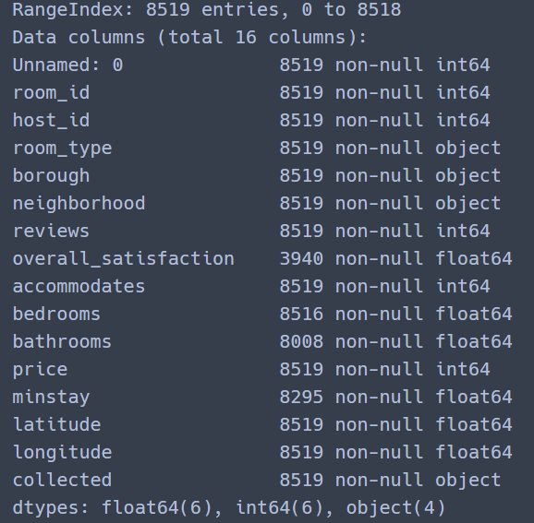
Data information
We dataset 2016-05 Seoul city
Feature total 16 columns
Unnamed : 0 -> csv file data index
Room_id -> room primary key
Host_id -> host primary key
Room_type -> share room, private room, apartment
Borough -> city name
Neighborhood -> Administrative area
Reviews -> number of reviews
Overall_satisfaction -> overall
Accommodates -> number of guests a listing can accommodate
Bedrooms -> number of bedrooms
Bathrooms -> number of bathrooms
Price -> how much
Minstay -> minimum minstay(host selelct)
Latitude
Longitude
Collected -> the date and time that the values were read from the Airbnb web site

Slide 2
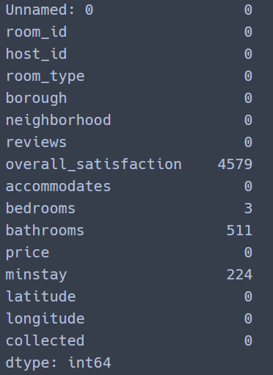
Missing Data

Slide 3
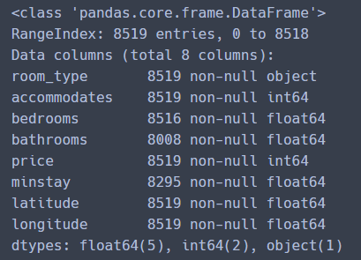
Feature drop

Slide 4
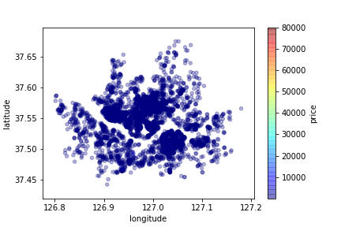
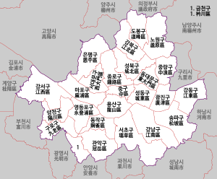
Seoul map

Slide 5
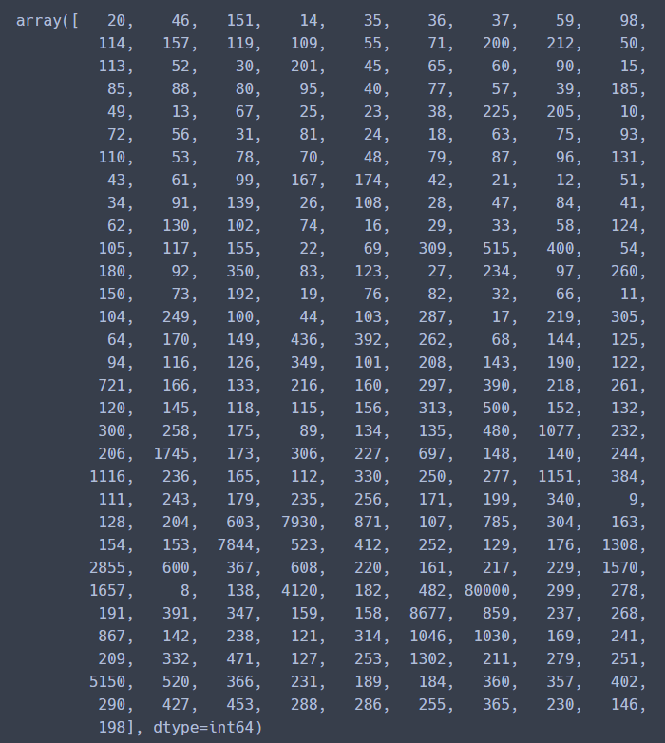
Price info

Slide 6
Price >= 200$
and
Accommodates < 6

Slide 7
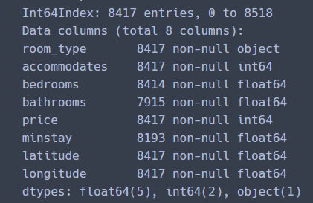
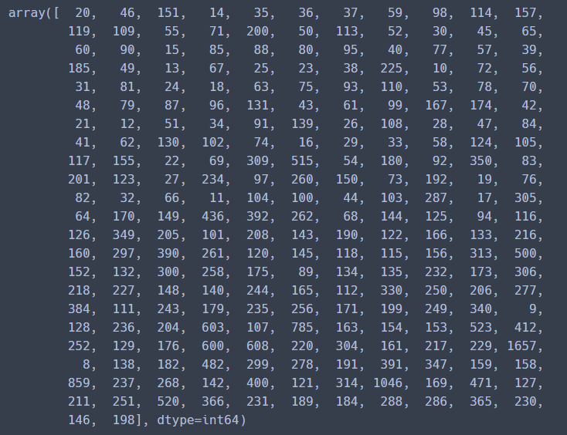
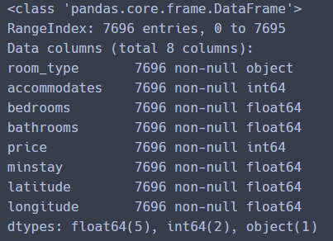
Missing value
Missing value Drop
Categorical data

Slide 8
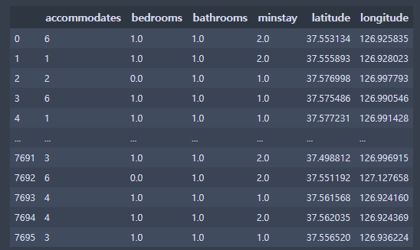


Data Slicing

Slide 9
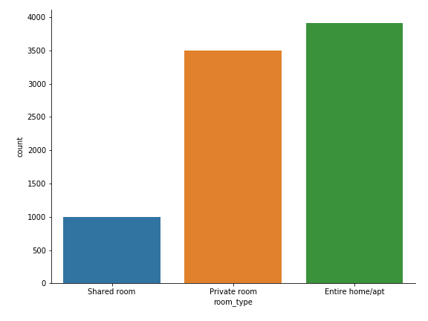
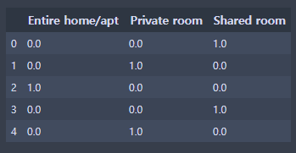
Room_type OneHotEncoder
Room_type bar

Slide 10
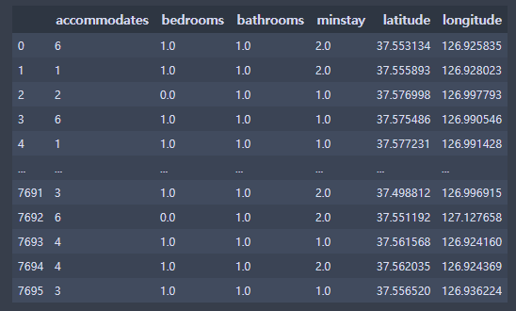
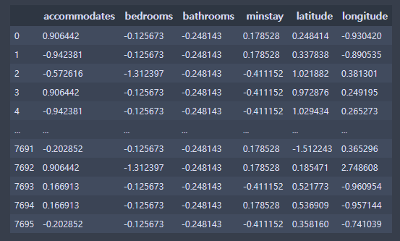
Data Scaler
Standard scaler

Slide 11
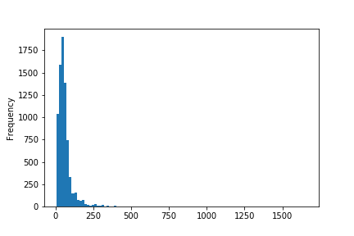
Price histogram
Group | Group_1 | Group_2 | Group_3 | Group_4 | Group_5 | Group_6
price | 0~50$ | 51~100$ | 101~150$ | 151~200$ | 201~500$ | 501~1657$

Slide 12
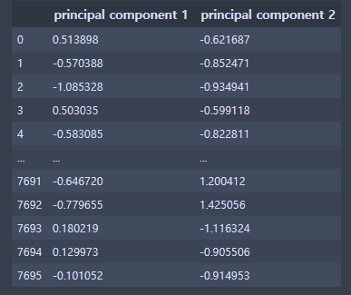
PCA 2Dimension

Slide 13
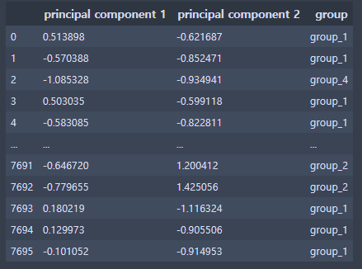
PCA data + group

Slide 14
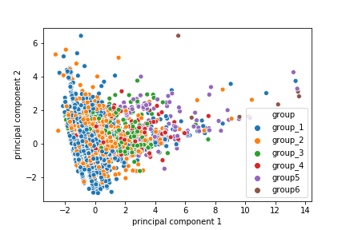
PCA 2D visualization

Slide 15
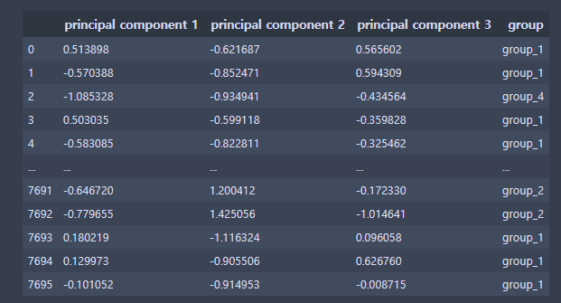
PCA 3Dimension

Slide 16
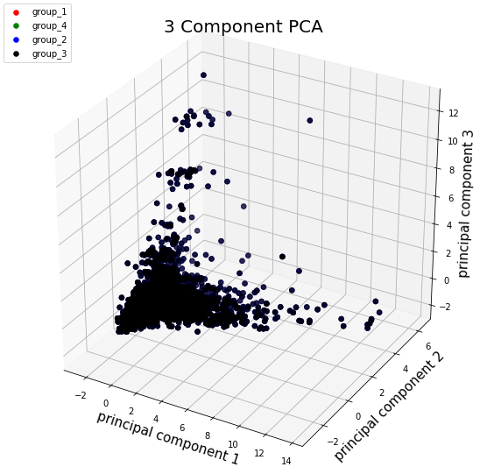
PCA 3D visualization

Slide 17
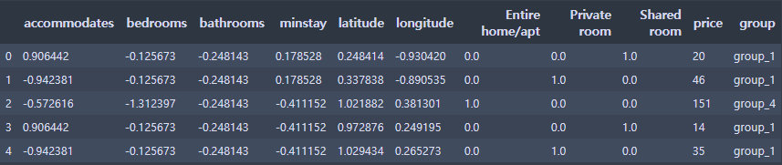
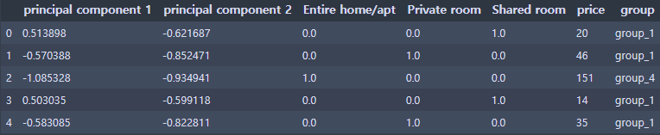
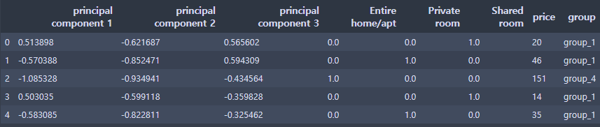
Original Data Concatenate
PCA 2D Data Concatenate
PCA 3D Data Concatenate

Slide 18
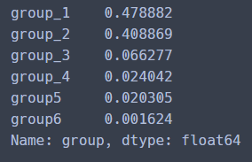
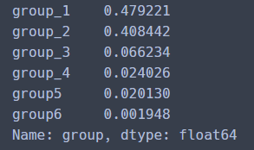
Stratified Shuffle Split (Train : 0.8, Test : 0.2)
Train_data
Test_data

Slide 19
Train and Test data cleaning
Drop Group Column
train_X,test_X Drop price
&
train_y, test_y = price

Slide 20
Default hyperparameter models performance
No PCA
Model | Random Forest | Neural Network | SVM
Train mean square | 15.886858640174635 | 41.26015967357692 | 48.990210993925814
Test mean square | 38.11525660039934 | 35.687984822263736 | 39.991565669217366
PCA 2D
Model | Random Forest | Neural Network | SVM
Train mean square | 18.851336252173947 | 43.48454304828039 | 50.11847075790632
Test mean square | 41.4673861833986 | 36.24433740860674 | 41.621196834954496
PCA 3D
Model | Random Forest | Neural Network | SVM
Train mean square | 17.36318761850783 | 43.18824583078685 | 49.274558661179924
Test mean square | 38.19675574378862 | 36.07539186904657 | 42.0103651402934

Slide 21
Thank you

